Slide 1

Design of Attendance Monitoring System
Using RFID
Dr. K.Periyakaruppan Professor and Head Department of Computer Science and Engineering SNS College of Engineering, Coimbatore kperiyakaruppan@gmail.com | Dr.S.K.B.Sangeetha Assistant Professor (Sr.G), Department of Computer Science and Engineering, SRM Institute of Science and Technology, Chennai sangeets8@srmist.edu.in | K. Aravindhan Assistant Professor Department of Computer Science and Engineering SNS College of Engineering, Coimbatore aravindhan03@gmail.com
K.P.Keerthana Assistant Professor Department of Electronic and Communication Engineering KGiSL Institute of Technology, Coimbatore keerthanaeie@gmail.com | V.Sanjay Giridhar UG Scholar Department of Computer Science and Engineering SNS College of Engineering, Coimbatore sanjaygiridhar20@gmail.com | V.Shamaladevi UG Scholar Department of Computer Science and Engineering SNS College of Engineering, Coimbatore vusdevi@gmail.com

Slide 2
ABSTRACT
This Attendance System With Storing Data on Google Spreadsheet Using RFID and Arduino Ethernet Shield. Now a days attendance management system is one of main thing in any organization. The pervious attendance system is too cost in this mainly we are reducing cost.
To make an attendance system based on RFID reader which will save attendance data in real time to google spreadsheet.
The objective of this system is to get the data in google sheet. And also we are not using a specific server to it we are using Google Cloud Platform to store Data.
The main objective is to reduce cost and to give simpler and efficient one.

Slide 3

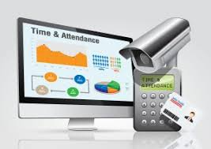
INTRODUCTION
Controlling costs in any business is one of the most critical elements of sound financial management.
Staffing costs are usually one of the biggest categories of spend for most businesses. This is why it is important to make staff planning and wage calculations as efficient and accurate as possible.
Wage labor involves the exchange of money for time spent at work

Slide 4
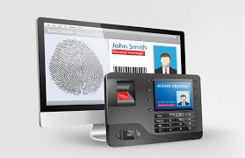


EXISTING SYSTEM
The existing system is biometrics which is over cost to implement in small organization.
The existing system also need a specific server to store the database.

Slide 5
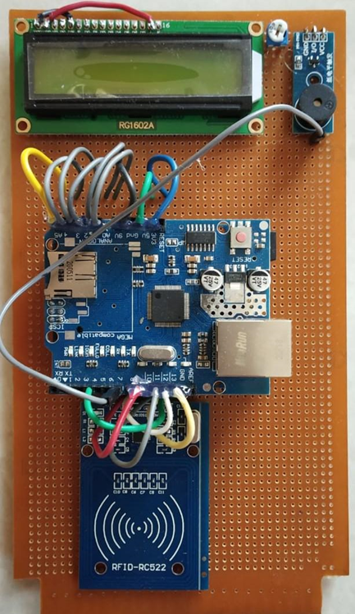
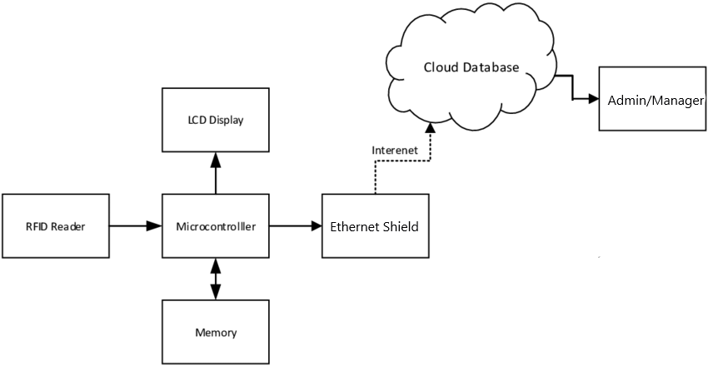
PROPOSED WORK
The RFID based attendance system has also enabled the organization administration to ensure only accredited people access the organization premises. This goes a long way in enhancing the general security within the organization.

Slide 6
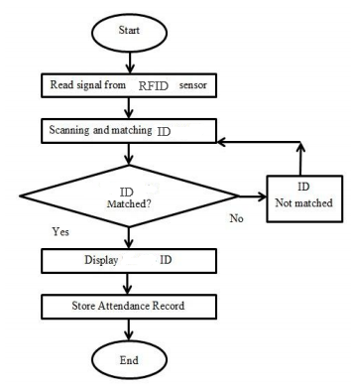
FLOW DIAGRAM

Slide 7
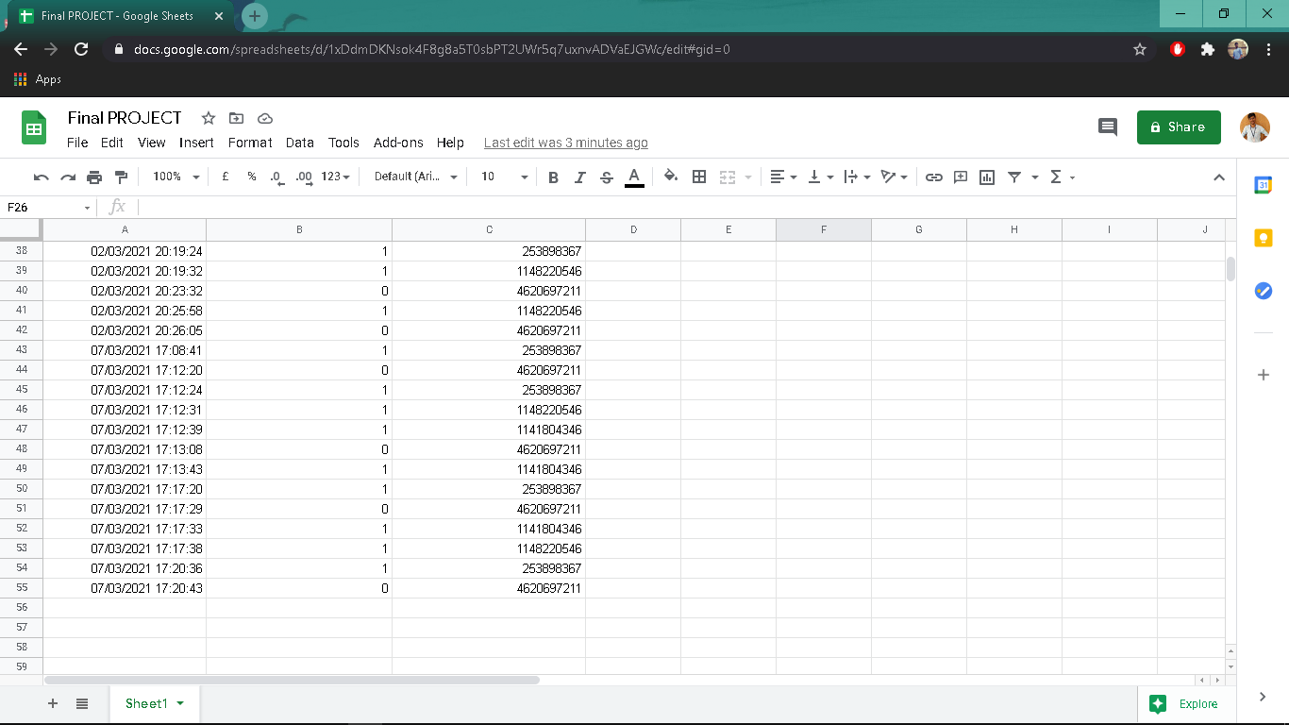
RESULTS

Slide 8
CONCLUSION & FUTURE WORK
The system prototype has several advantages compared to the conventional method
The prototype is easy to use with switches and communication ports that are easily accessible. Participation can be easily stored and recovered. The high identification and verification speed is also an advantage of the system.
A single board design of hardware is on process.
Work on local backup .
Moving the validation from controller to script.

Slide 9
References
D. R. Hancox, “Using RFID Technology to Enhance Corporate Effectiveness” ,April 2016.
International Organization for Standardization (ISO). (2003). Identification cards -- Contactless integrated circuit(s) cards -- Vicinity cards. ISO/IEC 14443.
Roy, W. (2006). An Introduction to RFID Technology. Pervasive Computing and Communications. IEEE Press. pp 25- 33.
Sato DCS & Labeling Worldwide, “The RFID Guidebook (Revision 8)”, 2004.
Radio-frequency identification. Wikipedia (online). Wikimedia Foundation, Inc., 2009.

Slide 10

QUESTION TIME

Slide 11
THANK YOU

